Slide 1

Team moneyball
Andrew Cowan, Daniel Fernandez, Kadien Peart, Drew Williams

Slide 2

Introduction

Slide 3
Questions we wanted to answer
A higher number of students at a school results in a higher number of posts
A higher number of students at a school results in a higher number of actions
A higher number of followers a user has will lead to a higher number of posts
A higher number of followers a user has will lead to a higher number of actions
The more likes a user receives will inspire more posts by the user
The more likes a user receives will inspire more actions by the user

Slide 4

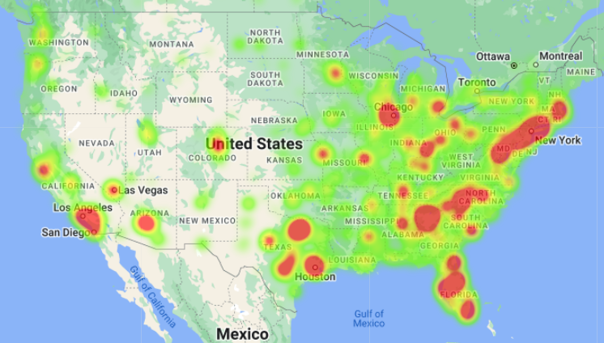
Data source
The team was able to obtain a large dataset containing information about each user from Press Sports via a CSV file. The file contained user-related information regarding their interaction with the app which was used to facilitate the analysis.
This data included user details such as:
IDs
School name
State
Number of Followers
Posts
Actions

Slide 5
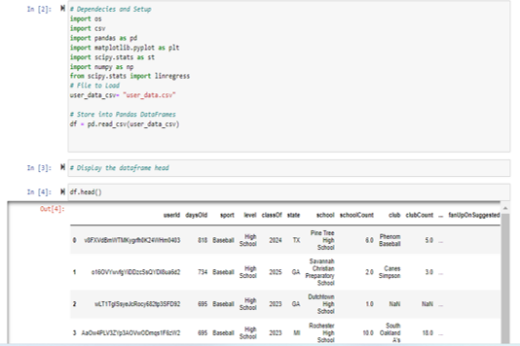
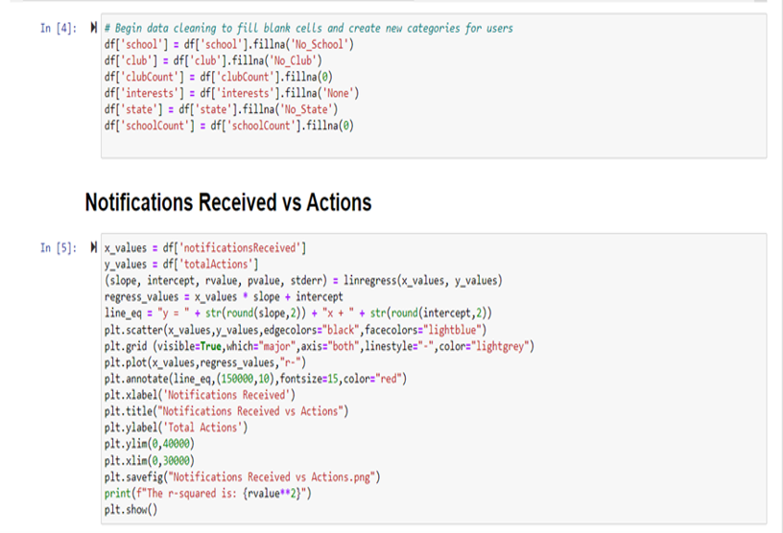
Data Exploration and cleaning

Slide 6
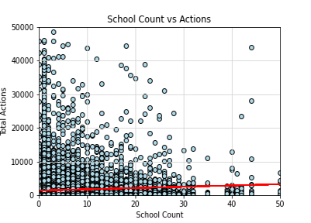
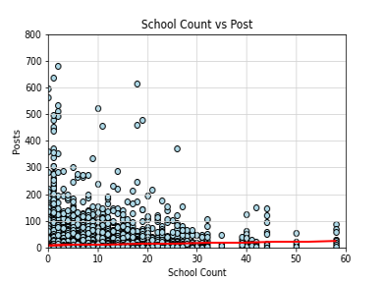
Data analysis
Testing the hypothesis that the higher number of students at a school will lead to a higher number of posts and actions.

Slide 7

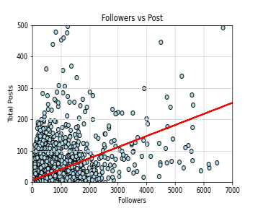
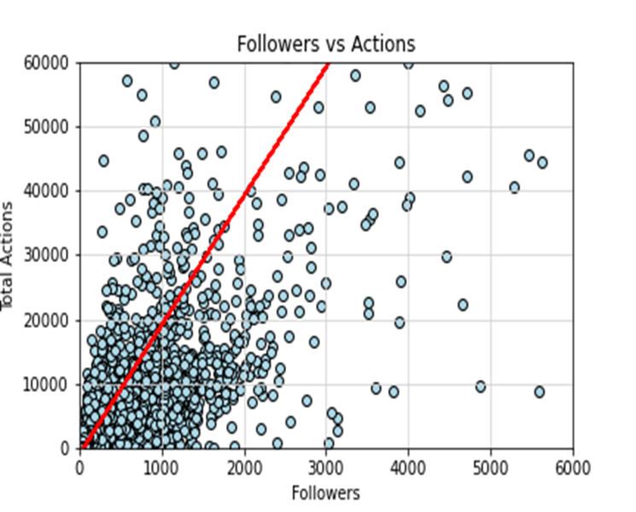
Data analysis
Testing the hypothesis that the more followers a user has will lead to a higher number of posts and actions.

Slide 8
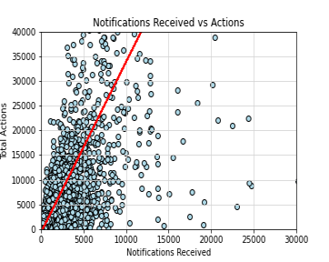
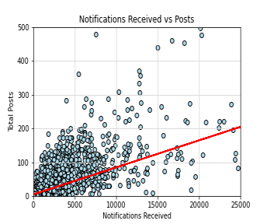
Data analysis
Testing the hypothesis that the more notifications a user receives will lead to a higher number of posts and actions.

Slide 9
Conclusions
Null Hypothesis | R-Value Squared | Answer
A higher number of students at a school does not impact number of posts | 0.004 | We were unable to reject the null hypothesis as the data indeed suggested there is no correlation
A higher number of students at a school does not impact the number of actions | 0.005 | We were unable to reject the null hypothesis as the data indeed suggested there is no correlation
A higher number of followers a user has will lead to a higher number of posts | 0.3101 | Although the data did not allow us to reject the null hypothesis, it did suggest that there is a mild correlation between the number of followers and user posts
A higher number of followers a user does not change number of actions | 0.6137 | We can reject the null hypothesis and accept the alternative hypothesis as the data indicated there is a stronger relationship between a higher number of followers and actions by the user
The more likes a user receives will not inspire more posts by the user | 0.5107 | We can accept the alternative hypothesis, as we observed that a higher number of likes does have a moderate correlation to the number of posts
The more likes a user receives will inspire more actions by the user | 0.5839 | We can accept the alternative hypothesis, as we observed that a higher number of likes does have a moderate correlation to the number of actions

Slide 10
Implications and Takeaways
With this analysis, there are several highlights that Press Sports will be better able to take away:
- A better understanding of the experience of their users and work to further develop the type of tools and actions that they will provide in the future to improve user engagement and retention.
- The business will also be able to leverage their current base of users to promote the app and increase market penetration by understanding what drives user engagement.
- Press Sports will also gain a better understanding of where their marketing campaigns or resources may be most effective by using the heatmap provided by Google Maps

